Slide 1
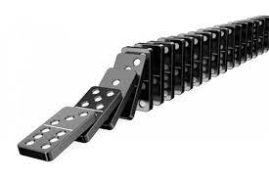

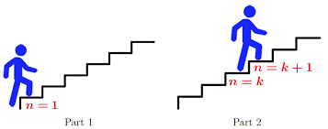
Chapter: 05 Induction and Recursion
5.1 Mathematical Induction
FREE: For Complete Playlist: https://www.youtube.com/c/FahadHussaintutorial/playlists
For Code, Slide and Books: https://fahadhussaincs.blogspot.com/

Slide 2
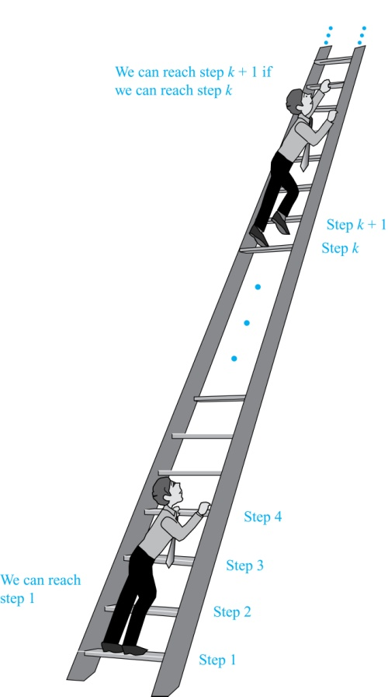
Chapter: 05, 5.1
Climbing an Infinite Ladder
Suppose we have an infinite ladder:
We can reach the first rung of the ladder.
If we can reach a particular rung of the ladder, then we can reach the next rung.
From (1), we can reach the first rung. Then by applying (2), we can reach the second rung. Applying (2) again, the third rung. And so on. We can apply (2) any number of times to reach any particular rung, no matter how high up.
This example motivates proof by mathematical induction.
FREE: For Complete Playlist: https://www.youtube.com/c/FahadHussaintutorial/playlists
For Code, Slide and Books: https://fahadhussaincs.blogspot.com/

Slide 3
Principle of Mathematical Induction
Principle of Mathematical Induction: To prove that P(n) is true for all positive integers n, we complete these steps:
Basis Step: Show that P(1) is true.
Inductive Step: Show that P(k) → P(k + 1) is true for all positive integers k.
To complete the inductive step, assuming the inductive hypothesis that P(k) holds for an arbitrary integer k, show that must P(k + 1) be true.
Climbing an Infinite Ladder Example:
BASIS STEP: By (1), we can reach rung 1.
INDUCTIVE STEP: Assume the inductive hypothesis that we can reach rung k. Then by (2), we can reach rung k + 1.
Hence, P(k) → P(k + 1) is true for all positive integers k. We can reach every rung on the ladder.
FREE: For Complete Playlist: https://www.youtube.com/c/FahadHussaintutorial/playlists
For Code, Slide and Books: https://fahadhussaincs.blogspot.com/

Slide 4
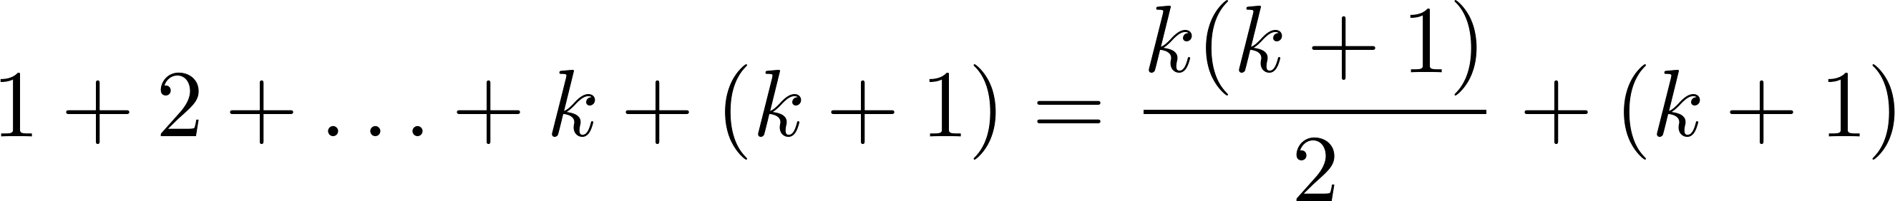
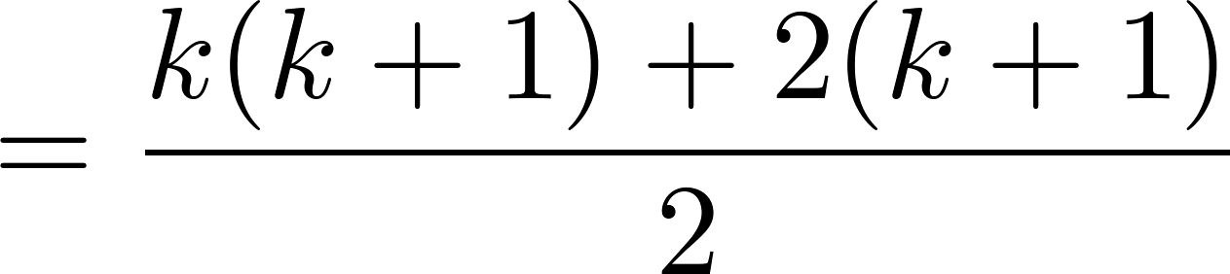
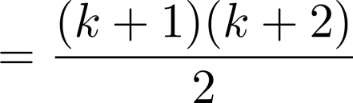
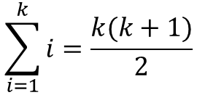
Proving a Summation Formula
Example: Show that:
Solution:
BASIS STEP: P(1) is true since 1(1 + 1)/2 = 1.
INDUCTIVE STEP: Assume the inductive hypothesis holds P(k) and then show that P(k + 1) holds has well.
The inductive hypothesis is
Under this assumption,
$$\sum_{i=1}^{k}{i=\frac{k(k+1)}{2}}$$
FREE: For Complete Playlist: https://www.youtube.com/c/FahadHussaintutorial/playlists
For Code, Slide and Books: https://fahadhussaincs.blogspot.com/

Slide 5
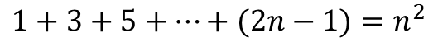
Conjecturing and Proving Correct a Summation Formula
Example: Conjecture and prove correct a formula for the sum of the first n positive odd integers. Then prove your conjecture.
Solution: We have: 1= 1, 1 + 3 = 4, 1 + 3 + 5 = 9, 1 + 3 + 5 + 7 = 16, 1 + 3 + 5 + 7 + 9 = 25.
We can conjecture that the sum of the first n positive odd integers is n²,
We prove the conjecture is proved correct with mathematical induction.
BASIS STEP: P(1) is true since 1² = 1.
INDUCTIVE STEP: P(k) → P(k + 1) for every positive integer k.
Assume the inductive hypothesis holds and then show that P(k + 1) holds has well.
So, assuming P(k), it follows that:
Hence, we have shown that P(k + 1) follows from P(k). Therefore the sum of the first n positive odd integers is n².
$$1+3+5+…+(2n−1)=n^{2}$$
Inductive Hypothesis: 1 + 3 + 5 + ∙∙∙+ (2k − 1) =k²
1 + 3 + 5 + ∙∙∙+ (2k − 1) + (2k + 1) =[1 + 3 + 5 + ∙∙∙+ (2k − 1)] + (2k + 1)
= k² + (2k + 1) (by the inductive hypothesis)
= k² + 2k + 1
= (k + 1) ²
FREE: For Complete Playlist: https://www.youtube.com/c/FahadHussaintutorial/playlists
For Code, Slide and Books: https://fahadhussaincs.blogspot.com/

Slide 6
Important Points About Using Mathematical Induction
Mathematical induction can be expressed as the rule of inference
where the domain is the set of positive integers.
In a proof by mathematical induction, we don’t assume that P(k) is true for all positive integers! We show that if we assume that P(k) is true, then P(k + 1) must also be true.
Proofs by mathematical induction do not always start at the integer 1. In such a case, the basis step begins at a starting point b where b is an integer.
(P(1) ∧ ∀k (P(k) → P(k + 1))) → ∀n P(n),
FREE: For Complete Playlist: https://www.youtube.com/c/FahadHussaintutorial/playlists
For Code, Slide and Books: https://fahadhussaincs.blogspot.com/

Slide 7
Proving Inequalities
Example: Use mathematical induction to prove that
n < 2^{n} for all positive integers n.
Solution: Let P(n) be the proposition that n < 2^{n}.
BASIS STEP: P(1) is true since 1 < 2¹ = 2.
INDUCTIVE STEP: Assume P(k) holds, i.e., k < 2^{k}, for an arbitrary positive integer k.
Must show that P(k + 1) holds. Since by the inductive hypothesis,
k < 2^{k}, it follows that:
k + 1 < 2^{k} + 1 ≤ 2^{k} + 2^{k}
= 2^{k} (1+1 )
= 2 ∙ 2^{k}
= 2^{k+1}
Therefore n < 2^{n} holds for all positive integers n.
FREE: For Complete Playlist: https://www.youtube.com/c/FahadHussaintutorial/playlists
For Code, Slide and Books: https://fahadhussaincs.blogspot.com/

Slide 8
Proving Inequalities
Example: Use mathematical induction to prove that 2^{n} < n!, for every integer n ≥ 4.
Solution: Let P(n) be the proposition that 2^{n} < n!.
BASIS STEP: P(4) is true since 2⁴ = 16 < 4! = 24.
INDUCTIVE STEP: Assume P(k) holds, i.e., 2^{k} < k! for an arbitrary integer k ≥ 4. To show that P(k + 1) holds:
2^{k+1} = 2∙2^{k}
< 2∙ k! (by the inductive hypothesis)
< (k + 1)k!
= (k + 1)!
Therefore, 2^{n} < n! holds, for every integer n ≥ 4.
Note that here the basis step is P(4), since P(0), P(1), P(2), and P(3) are all false.
FREE: For Complete Playlist: https://www.youtube.com/c/FahadHussaintutorial/playlists
For Code, Slide and Books: https://fahadhussaincs.blogspot.com/

Slide 9
Proving Divisibility Results
Example: Use mathematical induction to prove that n³ − n is divisible by 3, for every positive integer n.
Solution: Let P(n) be the proposition that n³ − n is divisible by 3.
BASIS STEP: P(1) is true since 1³ − 1 = 0, which is divisible by 3.
INDUCTIVE STEP: Assume P(k) holds, i.e., k³ − k is divisible by 3, for an arbitrary positive integer k. To show that P(k + 1) follows:
(k + 1)³ − (k + 1) = (k³ + 3k² + 3k + 1) − (k + 1)
= (k³ − k) + 3(k² + k)
By the inductive hypothesis, the first term (k³ − k) is divisible by 3 and the second term is divisible by 3 since it is an integer multiplied by 3. So by part (i) of Theorem 1 in Section 4.1 , (k + 1)³ − (k + 1) is divisible by 3.
Therefore, n³ − n is divisible by 3, for every positive integer n.
FREE: For Complete Playlist: https://www.youtube.com/c/FahadHussaintutorial/playlists
For Code, Slide and Books: https://fahadhussaincs.blogspot.com/

Slide 10


Tiling Checkerboards
Example: Show that every 2^{n} ×2^{n} checkerboard with one square removed can be tiled using right triominoes.
Solution: Let P(n) be the proposition that every 2^{n} ×2^{n} checkerboard with one square removed can be tiled using right triominoes. Use mathematical induction to prove that P(n) is true for all positive integers n.
BASIS STEP: P(1) is true, because each of the four 2 ×2 checkerboards with one square removed can be tiled using one right triomino.
INDUCTIVE STEP: Assume that P(k) is true for every 2^{k} ×2^{k} checkerboard, for some positive integer k.
A right triomino is an L-shaped tile which covers three squares at a time.
continued →
FREE: For Complete Playlist: https://www.youtube.com/c/FahadHussaintutorial/playlists
For Code, Slide and Books: https://fahadhussaincs.blogspot.com/

Slide 11
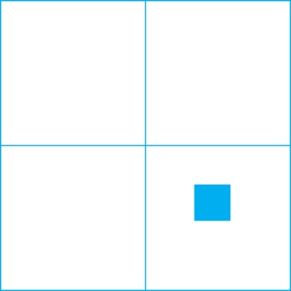

Tiling Checkerboards
Consider a 2^{k+1} ×2^{k+1} checkerboard with one square removed. Split this checkerboard into four checkerboards of size 2^{k} ×2^{k},by dividing it in half in both directions.
Remove a square from one of the four 2^{k} ×2^{k} checkerboards. By the inductive hypothesis, this board can be tiled. Also by the inductive hypothesis, the other three boards can be tiled with the square from the corner of the center of the original board removed. We can then cover the three adjacent squares with a triominoe.
Hence, the entire 2^{k+1} ×2^{k+1} checkerboard with one square removed can be tiled using right triominoes.
Inductive Hypothesis: Every 2^{k} ×2^{k} checkerboard, for some positive integer k, with one square removed can be tiled using right triominoes.
FREE: For Complete Playlist: https://www.youtube.com/c/FahadHussaintutorial/playlists
For Code, Slide and Books: https://fahadhussaincs.blogspot.com/

Slide 12
An Incorrect “Proof” by Mathematical Induction
Example: Let P(n) be the statement that every set of n lines in the plane, no two of which are parallel, meet in a common point. Here is a “proof” that P(n) is true for all positive integers n ≥ 2.
BASIS STEP: The statement P(2) is true because any two lines in the plane that are not parallel meet in a common point.
INDUCTIVE STEP: The inductive hypothesis is the statement that P(k) is true for the positive integer k ≥ 2, i.e., every set of k lines in the plane, no two of which are parallel, meet in a common point.
We must show that if P(k) holds, then P(k + 1) holds, i.e., if every set of k lines in the plane, no two of which are parallel, k ≥ 2, meet in a common point, then every set of k + 1 lines in the plane, no two of which are parallel, meet in a common point.
continued →
FREE: For Complete Playlist: https://www.youtube.com/c/FahadHussaintutorial/playlists
For Code, Slide and Books: https://fahadhussaincs.blogspot.com/

Slide 13
An Incorrect “Proof” by Math. Induction
Inductive Hypothesis: Every set of k lines in the plane, where k ≥ 2, no two of which are parallel, meet in a common point.
Consider a set of k + 1 distinct lines in the plane, no two parallel. By the inductive hypothesis, the first k of these lines must meet in a common point p₁. By the inductive hypothesis, the last k of these lines meet in a common point p₂.
If p₁ and p₂ are different points, all lines containing both of them must be the same line since two points determine a line. This contradicts the assumption that the lines are distinct. Hence, p₁ = p₂ lies on all k + 1 distinct lines, and therefore P(k + 1) holds. Assuming that k ≥2, distinct lines meet in a common point, then every k + 1 lines meet in a common point.
There must be an error in this proof since the conclusion is absurd. But where is the error?
Answer: P(k)→ P(k + 1) only holds for k ≥3. It is not the case that P(2) implies P(3). The first two lines must meet in a common point p₁ and the second two must meet in a common point p₂. They do not have to be the same point since only the second line is common to both sets of lines.
FREE: For Complete Playlist: https://www.youtube.com/c/FahadHussaintutorial/playlists
For Code, Slide and Books: https://fahadhussaincs.blogspot.com/

Slide 14
Additional Reading Recourses
https://www.math-only-math.com/proof-by-mathematical-induction.html
https://www.mathsisfun.com/algebra/mathematical-induction.html
FREE: For Complete Playlist: https://www.youtube.com/c/FahadHussaintutorial/playlists
For Code, Slide and Books: https://fahadhussaincs.blogspot.com/

Slide 15
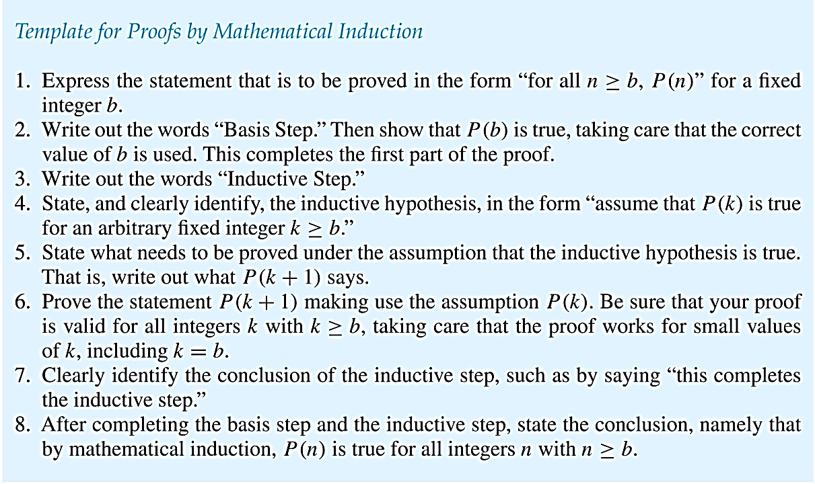
Guidelines: Mathematical Induction Proofs
FREE: For Complete Playlist: https://www.youtube.com/c/FahadHussaintutorial/playlists
For Code, Slide and Books: https://fahadhussaincs.blogspot.com/

Slide 16
Strong Induction and Well-Ordering
Section 5.2

Slide 17
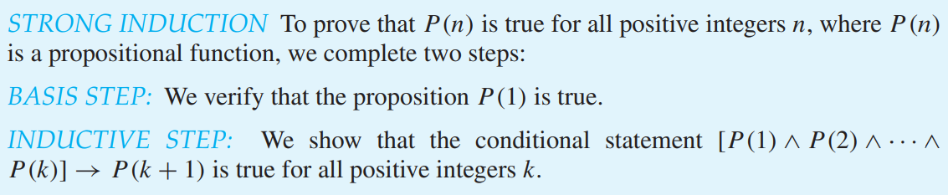
Strong Induction
Strong Induction: To prove that P(n) is true for all positive integers n, where P(n) is a propositional function, complete two steps:
Strong Induction is sometimes called the second principle of mathematical induction or complete induction.
FREE: For Complete Playlist: https://www.youtube.com/c/FahadHussaintutorial/playlists
For Code, Slide and Books: https://fahadhussaincs.blogspot.com/

Slide 18
Strong Induction and the Infinite Ladder
Strong induction tells us that we can reach all rungs if:
We can reach the first rung of the ladder.
For every integer k, if we can reach the first k rungs, then we can reach the (k + 1)st rung.
To conclude that we can reach every rung by strong induction:
BASIS STEP: P(1) holds
INDUCTIVE STEP: Assume P(1) ∧ P(2) ∧∙∙∙ ∧ P(k)
holds for an arbitrary integer k, and show that
P(k + 1) must also hold.
We will have then shown by strong induction that for every positive integer n, P(n) holds, i.e., we can
reach the nth rung of the ladder.
FREE: For Complete Playlist: https://www.youtube.com/c/FahadHussaintutorial/playlists
For Code, Slide and Books: https://fahadhussaincs.blogspot.com/

Slide 19
Proof using Strong Induction
Example: Suppose we can reach the first and second rungs of an infinite ladder, and we know that if we can reach a rung, then we can reach two rungs higher. Prove that we can reach every rung.
(Try this with mathematical induction.)
Solution: Prove the result using strong induction.
BASIS STEP: We can reach the first step.
INDUCTIVE STEP: The inductive hypothesis is that we can reach the first k rungs, for any k ≥ 2. We can reach the (k + 1)st rung since we can reach the (k − 1)st rung by the inductive hypothesis.
Hence, we can reach all rungs of the ladder.
FREE: For Complete Playlist: https://www.youtube.com/c/FahadHussaintutorial/playlists
For Code, Slide and Books: https://fahadhussaincs.blogspot.com/

Slide 20
Which Form of Induction Should Be Used?
We can always use strong induction instead of mathematical induction. But there is no reason to use it if it is simpler to use mathematical induction. (See page 335 of text.)
In fact, the principles of mathematical induction, strong induction, and the well-ordering property are all equivalent. (Exercises 41-43)
Sometimes it is clear how to proceed using one of the three methods, but not the other two.
FREE: For Complete Playlist: https://www.youtube.com/c/FahadHussaintutorial/playlists
For Code, Slide and Books: https://fahadhussaincs.blogspot.com/

Slide 21
Proof using Strong Induction
Example: Prove that every amount of postage of 12 cents or more can be formed using just 4-cent and 5-cent stamps.
Solution: Let P(n) be the proposition that postage of n cents can be formed using 4-cent and 5-cent stamps.
BASIS STEP: P(12), P(13), P(14), and P(15) hold.
P(12) uses three 4-cent stamps.
P(13) uses two 4-cent stamps and one 5-cent stamp.
P(14) uses one 4-cent stamp and two 5-cent stamps.
P(15) uses three 5-cent stamps.
INDUCTIVE STEP: The inductive hypothesis states that P(j) holds for 12 ≤ j ≤ k, where k ≥ 15. Assuming the inductive hypothesis, it can be shown that P(k + 1) holds.
Using the inductive hypothesis, P(k − 3) holds since k − 3 ≥ 12. To form postage of k + 1 cents, add a 4-cent stamp to the postage for k − 3 cents.
Hence, P(n) holds for all n ≥ 12.
FREE: For Complete Playlist: https://www.youtube.com/c/FahadHussaintutorial/playlists
For Code, Slide and Books: https://fahadhussaincs.blogspot.com/

Slide 22
Proof of the Same Example using Mathematical Induction
Example: Prove that every amount of postage of 12 cents or more can be formed using just 4-cent and 5-cent stamps.
Solution: Let P(n) be the proposition that postage of n cents can be formed using 4-cent and 5-cent stamps.
BASIS STEP: Postage of 12 cents can be formed using three 4-cent stamps.
INDUCTIVE STEP: The inductive hypothesis P(k) for any positive integer k is that postage of k cents can be formed using 4-cent and 5-cent stamps. To show P(k + 1) where k ≥ 12 , we consider two cases:
If at least one 4-cent stamp has been used, then a 4-cent stamp can be replaced with a 5-cent stamp to yield a total of k + 1 cents.
Otherwise, no 4-cent stamp have been used and at least three 5-cent stamps were used. Three 5-cent stamps can be replaced by four 4-cent stamps to yield a total of k + 1 cents.
Hence, P(n) holds for all n ≥ 12.
FREE: For Complete Playlist: https://www.youtube.com/c/FahadHussaintutorial/playlists
For Code, Slide and Books: https://fahadhussaincs.blogspot.com/

Slide 23
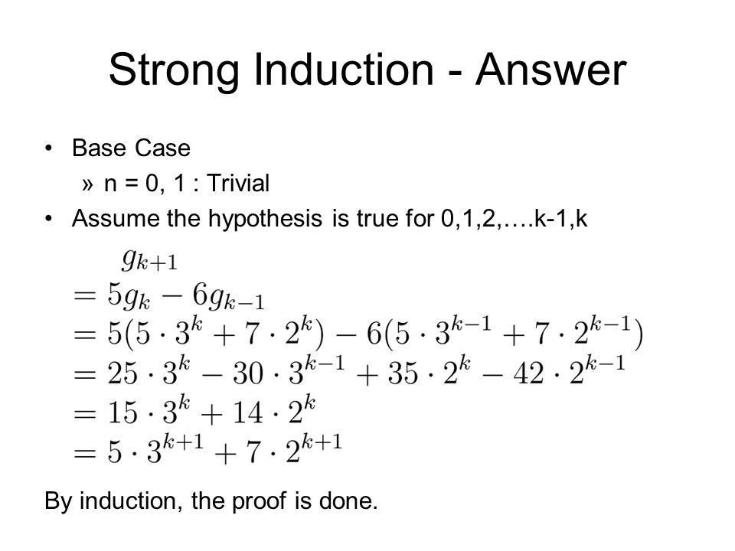
FREE: For Complete Playlist: https://www.youtube.com/c/FahadHussaintutorial/playlists
For Code, Slide and Books: https://fahadhussaincs.blogspot.com/

Slide 24
Fundamental Theorem of Arithmetic
Theorem: If n is an integer greater than 1, then n can be written as the product of primes.
Proof: Let P(n) be the proposition that n can be written as a product of primes.
BASIS STEP: P(2) is true since 2 itself is prime.
INDUCTIVE STEP: The inductive hypothesis is P(j) is true for all integers j with 2 ≤ j ≤ k. To show that P(k + 1) must be true under this assumption, two cases need to be considered:
If k + 1 is prime, then P(k + 1) is true.
Otherwise, k + 1 is composite and can be written as the product of two positive integers a and b with 2 ≤ a ≤ b < k + 1. By the inductive hypothesis a and b can be written as the product of primes and therefore k + 1 can also be written as the product of those primes.
Hence, it has been shown that every integer greater than 1 can be written as the product of primes.
(uniqueness proved in Section 4.3)
FREE: For Complete Playlist: https://www.youtube.com/c/FahadHussaintutorial/playlists
For Code, Slide and Books: https://fahadhussaincs.blogspot.com/

Slide 25
Well-Ordering Property
Well-ordering property: Every nonempty set of nonnegative integers has a least element.
The well-ordering property is one of the axioms of the positive integers listed in Appendix 1.
The well-ordering property can be used directly in proofs, as the next example illustrates.
The well-ordering property can be generalized.
Definition: A set is well ordered if every subset has a least element.
N is well ordered under ≤.
The set of finite strings over an alphabet using lexicographic ordering is well ordered.
We will see a generalization of induction to sets other than the integers in the next section.
FREE: For Complete Playlist: https://www.youtube.com/c/FahadHussaintutorial/playlists
For Code, Slide and Books: https://fahadhussaincs.blogspot.com/

Slide 26
Well-Ordering Property
Example: Use the well-ordering property to prove the division algorithm, which states that if a is an integer and d is a positive integer, then there are unique integers q and r with 0 ≤ r < d, such that a = dq + r.
Solution: Let S be the set of nonnegative integers of the form a − dq, where q is an integer. The set is nonempty since −dq can be made as large as needed.
By the well-ordering property, S has a least element r = a − dq₀. The integer r is nonnegative. It also must be the case that r < d. If it were not, then there would be a smaller nonnegative element in S, namely, a − d(q₀ + 1) = a − dq₀ − d = r − d > 0.
Therefore, there are integers q and r with 0 ≤ r < d.
⁻² .
FREE: For Complete Playlist: https://www.youtube.com/c/FahadHussaintutorial/playlists
For Code, Slide and Books: https://fahadhussaincs.blogspot.com/

Slide 27
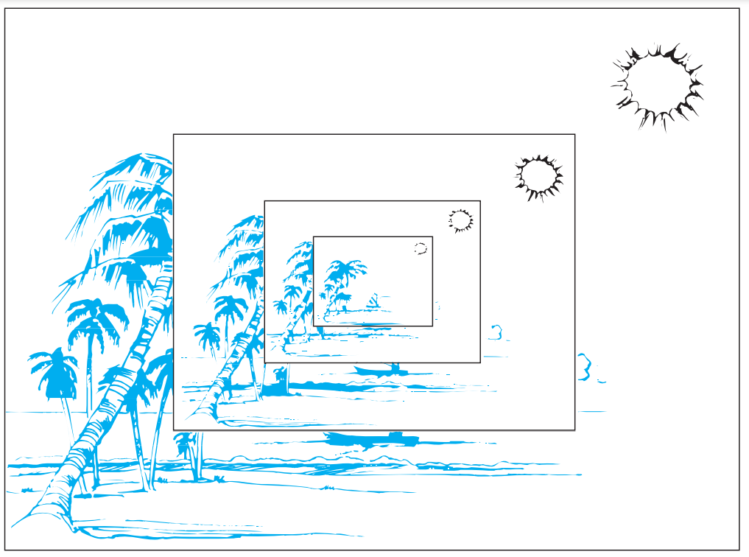
5.3 Recursive Definitions and Structural Induction
Sometimes it is difficult to define an object explicitly. However, it may be easy to define this object in terms of itself. This process is called recursion. For instance, the picture shown in Figure
We can use recursion to define sequences, functions, and sets.
FREE: For Complete Playlist: https://www.youtube.com/c/FahadHussaintutorial/playlists
For Code, Slide and Books: https://fahadhussaincs.blogspot.com/

Slide 28
Recursively Defined Functions
Definition: A recursive or inductive definition of a function consists of two steps.
BASIS STEP: Specify the value of the function at zero.
RECURSIVE STEP: Give a rule for finding its value at an integer from its values at smaller integers.
FREE: For Complete Playlist: https://www.youtube.com/c/FahadHussaintutorial/playlists
For Code, Slide and Books: https://fahadhussaincs.blogspot.com/

Slide 29
Recursively Defined Functions
Example: Suppose f is defined by:
f(0) = 3,
f(n + 1) = 2f(n) + 3
Find f(1), f(2), f(3), f(4)
Solution:
f(1) = 2f(0) + 3 = 2∙3 + 3 = 9
f(2) = 2f(1)+ 3 = 2∙9 + 3 = 21
f(3) = 2f(2) + 3 = 2∙21 + 3 = 45
f(4) = 2f(3) + 3 = 2∙45 + 3 = 93
Example: Give a recursive definition of the factorial function n!:
Solution:
f(0) = 1
f(n + 1) = (n + 1)∙ f(n)
FREE: For Complete Playlist: https://www.youtube.com/c/FahadHussaintutorial/playlists
For Code, Slide and Books: https://fahadhussaincs.blogspot.com/

Slide 30
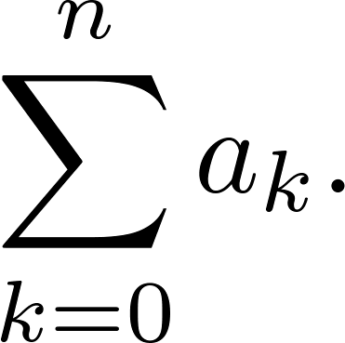
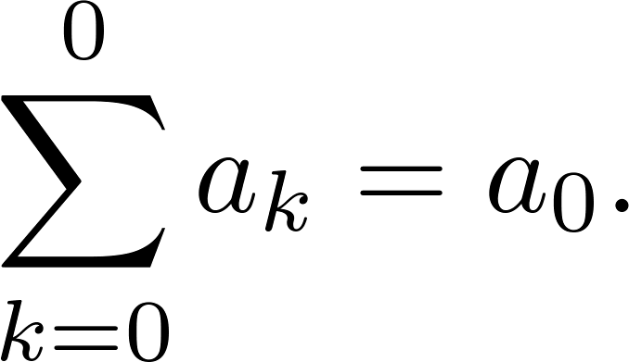
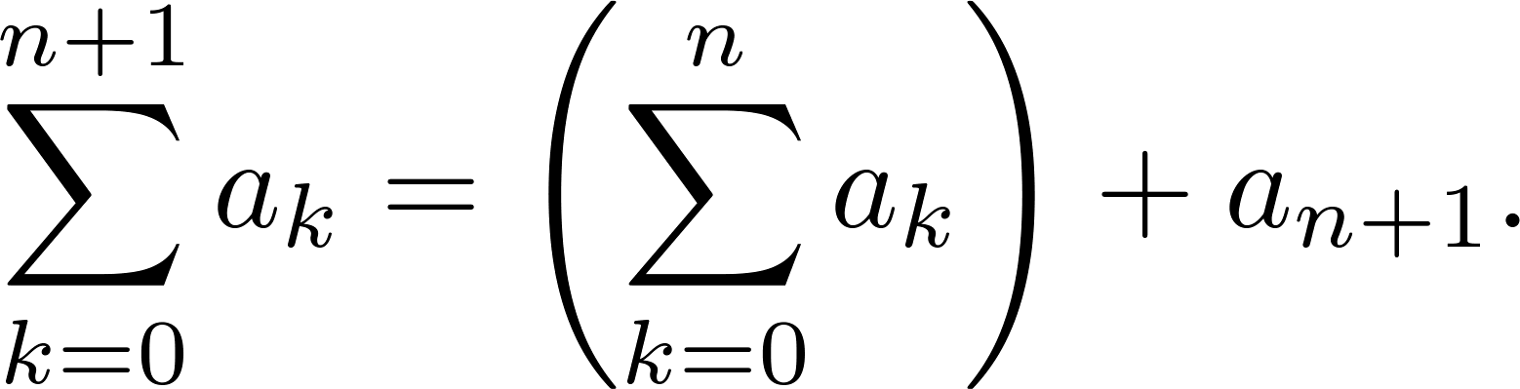
Recursively Defined Functions
Example: Give a recursive definition of:
Solution: The first part of the definition is
The second part is
FREE: For Complete Playlist: https://www.youtube.com/c/FahadHussaintutorial/playlists
For Code, Slide and Books: https://fahadhussaincs.blogspot.com/

Slide 31
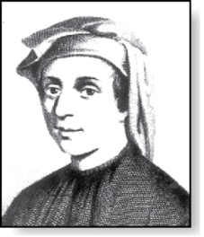
Fibonacci Numbers
Fibonacci
(1170- 1250)
Example : The Fibonacci numbers are defined as follows:
f₀ = 0
f₁ = 1
f_{n} = f_{n−1} + f_{n−2}
Find f₂, f₃ , f₄ , f₅ .
f₂ = f₁ + f₀ = 1 + 0 = 1
f₃ = f₂ + f₁ = 1 + 1 = 2
f₄ = f₃ + f₂ = 2 + 1 = 3
f₅ = f₄ + f₃ = 3 + 2 = 5
FREE: For Complete Playlist: https://www.youtube.com/c/FahadHussaintutorial/playlists
For Code, Slide and Books: https://fahadhussaincs.blogspot.com/

Slide 32
Recursively Defined Sets and Structures
Recursive definitions of sets have two parts:
The basis step specifies an initial collection of elements.
The recursive step gives the rules for forming new elements in the set from those already known to be in the set.
Sometimes the recursive definition has an exclusion rule, which specifies that the set contains nothing other than those elements specified in the basis step and generated by applications of the rules in the recursive step.
We will always assume that the exclusion rule holds, even if it is not explicitly mentioned.
FREE: For Complete Playlist: https://www.youtube.com/c/FahadHussaintutorial/playlists
For Code, Slide and Books: https://fahadhussaincs.blogspot.com/

Slide 33
Recursively Defined Sets and Structures
Example : Subset of Integers S:
BASIS STEP: 3 ∊ S.
RECURSIVE STEP: If x ∊ S and y ∊ S, then x + y is in S.
Initially 3 is in S, then 3 + 3 = 6, then 3 + 6 = 9, etc.
Example: The natural numbers N.
BASIS STEP: 0 ∊ N.
RECURSIVE STEP: If n is in N, then n + 1 is in N.
Initially 0 is in S, then 0 + 1 = 1, then 1 + 1 = 2, etc.
FREE: For Complete Playlist: https://www.youtube.com/c/FahadHussaintutorial/playlists
For Code, Slide and Books: https://fahadhussaincs.blogspot.com/

Slide 34
Strings
Recursively Defined Structures
Definition: The set Σ* of strings over the alphabet Σ:
BASIS STEP: λ ∊ Σ* (λ is the empty string)
RECURSIVE STEP: If w is in Σ* and x is in Σ,
then wx ∈ Σ*.
Example: If Σ = {0,1}, the strings in in Σ* are the set of all bit strings, λ,0,1, 00,01,10, 11, etc.
Example: If Σ = {a,b}, show that aab is in Σ*.
Since λ ∊ Σ* and a ∊ Σ, a ∊ Σ*.
Since a ∊ Σ* and a ∊ Σ, aa ∊ Σ*.
Since aa ∊ Σ* and b ∊ Σ, aab ∊ Σ*.
FREE: For Complete Playlist: https://www.youtube.com/c/FahadHussaintutorial/playlists
For Code, Slide and Books: https://fahadhussaincs.blogspot.com/

Slide 35
String Concatenation
Definition: Two strings can be combined via the operation of concatenation. Let Σ be a set of symbols and Σ* be the set of strings formed from the symbols in Σ. We can define the concatenation of two strings, denoted by ∙, recursively as follows.
BASIS STEP: If w ∈ Σ*, then w ∙ λ= w.
RECURSIVE STEP: If w₁ ∈ Σ* and w₂ ∈ Σ* and x ∈ Σ, then w₁ ∙ (w₂ x)= (w₁ ∙ w₂)x.
Often w₁ ∙ w₂ is written as w₁ w₂.
If w₁ = abra and w₂ = cadabra, the concatenation w₁ w₂ = abracadabra.
FREE: For Complete Playlist: https://www.youtube.com/c/FahadHussaintutorial/playlists
For Code, Slide and Books: https://fahadhussaincs.blogspot.com/

Slide 36
Length of a String
Example: Give a recursive definition of l(w), the length of the string w.
Solution: The length of a string can be recursively defined by:
l(λ) = 0;
l(wx) = l(w) + 1 if w ∊ Σ* and x ∊ Σ.
FREE: For Complete Playlist: https://www.youtube.com/c/FahadHussaintutorial/playlists
For Code, Slide and Books: https://fahadhussaincs.blogspot.com/

Slide 37
Balanced Parentheses
Example: Give a recursive definition of the set of balanced parentheses P.
Solution:
BASIS STEP: () ∊ P
RECURSIVE STEP: If w ∊ P, then () w ∊ P, (w) ∊ P and w () ∊ P.
Show that (() ()) is in P.
Why is ))(() not in P?
FREE: For Complete Playlist: https://www.youtube.com/c/FahadHussaintutorial/playlists
For Code, Slide and Books: https://fahadhussaincs.blogspot.com/

Slide 38
Well-Formed Formulae in Propositional Logic
Definition: The set of well-formed formulas in propositional logic involving T, F, propositional variables, and operators from the set {¬,∧,∨,→,↔}.
BASIS STEP: T,F, and s, where s is a propositional variable, are well-formed formulae.
RECURSIVE STEP: If E and F are well formed formulas, then
(¬ E), (E ∧ F), (E ∨ F), (E → F), (E ↔ F), are well-formed formulas.
Examples: ((p ∨ q) → (q ∧ F)) is a well-formed formula.
pq ∧ is not a well formed formula.
FREE: For Complete Playlist: https://www.youtube.com/c/FahadHussaintutorial/playlists
For Code, Slide and Books: https://fahadhussaincs.blogspot.com/

Slide 39
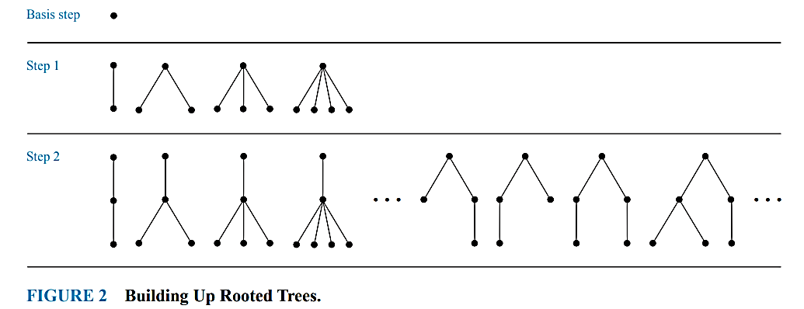
Rooted Trees
The set of rooted trees, where a rooted tree consists of a set of vertices containing a distinguished vertex called the root, and edges connecting these vertices, can be defined recursively by these steps:
BASIS STEP: A single vertex r is a rooted tree.
RECURSIVE STEP: Suppose that T1, T2,...,Tn are disjoint rooted trees with roots r1, r2,...,rn, respectively. Then the graph formed by starting with a root r, which is not in any of the rooted trees T1, T2,...,Tn, and adding an edge from r to each of the vertices r1, r2,...,rn, is also a rooted tree
FREE: For Complete Playlist: https://www.youtube.com/c/FahadHussaintutorial/playlists
For Code, Slide and Books: https://fahadhussaincs.blogspot.com/

Slide 40
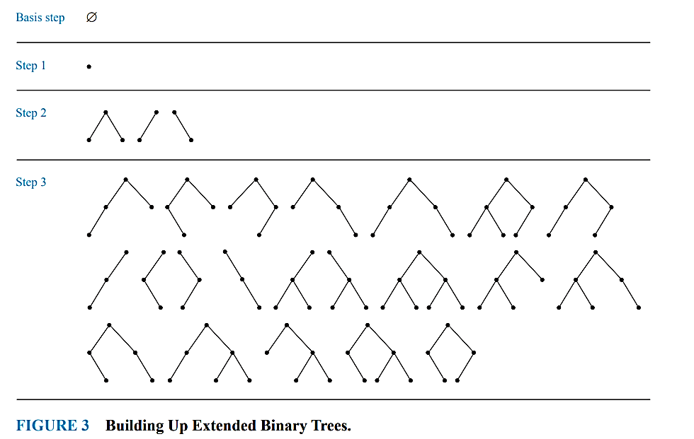
Extended Binary Trees
The set of extended binary trees can be defined recursively by these steps:
BASIS STEP: The empty set is an extended binary tree.
RECURSIVE STEP: If T1 and T2 are disjoint extended binary trees, there is an extended binary tree, denoted by T1 · T2, consisting of a root r together with edges connecting the root to each of the roots of the left subtree T1 and the right subtree T2 when these trees are nonempty.
FREE: For Complete Playlist: https://www.youtube.com/c/FahadHussaintutorial/playlists
For Code, Slide and Books: https://fahadhussaincs.blogspot.com/

Slide 41
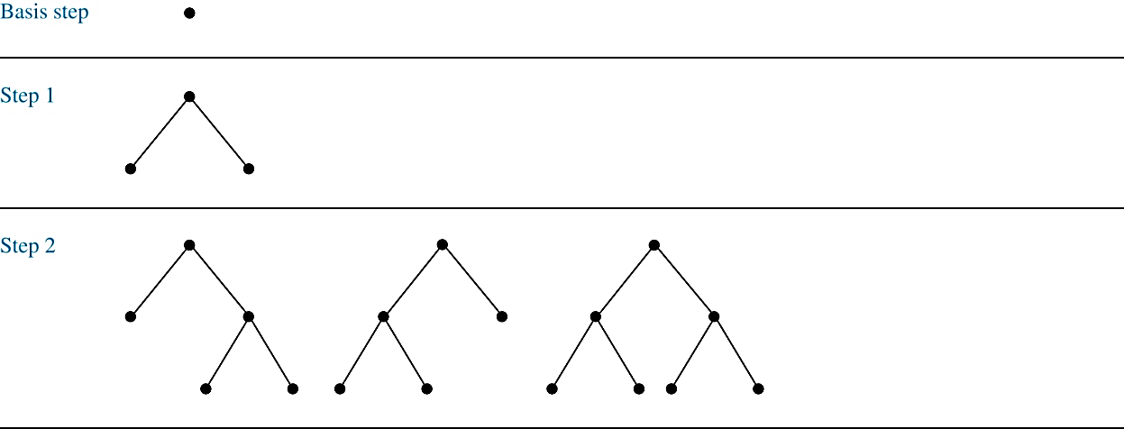
Full Binary Trees
Definition: The set of full binary trees can be defined recursively by these steps.
BASIS STEP: There is a full binary tree consisting of only a single vertex r.
RECURSIVE STEP: If T₁ and T₂ are disjoint full binary trees, there is a full binary tree, denoted by T₁∙T₂, consisting of a root r together with edges connecting the root to each of the roots of the left subtree T₁ and the right subtree T₂.
FREE: For Complete Playlist: https://www.youtube.com/c/FahadHussaintutorial/playlists
For Code, Slide and Books: https://fahadhussaincs.blogspot.com/

Slide 42
Structural Induction
Definition: To prove a property of the elements of a recursively defined set, we use structural induction.
BASIS STEP: Show that the result holds for all elements specified in the basis step of the recursive definition.
RECURSIVE STEP: Show that if the statement is true for each of the elements used to construct new elements in the recursive step of the definition, the result holds for these new elements.
The validity of structural induction can be shown to follow from the principle of mathematical induction.
FREE: For Complete Playlist: https://www.youtube.com/c/FahadHussaintutorial/playlists
For Code, Slide and Books: https://fahadhussaincs.blogspot.com/

Slide 43
Induction and Recursively Defined Sets
Example: Show that the set S defined by specifying that 3 ∊ S and that if x ∊ S and y ∊ S, then x + y is in S, is the set of all positive integers that are multiples of 3.
Solution: Let A be the set of all positive integers divisible by 3. To prove that A = S, show that A is a subset of S and S is a subset of A.
A⊂ S: Let P(n) be the statement that 3n belongs to S.
BASIS STEP: 3∙1 = 3 ∊ S, by the first part of recursive definition.
INDUCTIVE STEP: Assume P(k) is true. By the second part of the recursive definition, if 3k ∊ S, then since 3 ∊ S, 3k + 3 = 3(k + 1) ∊ S. Hence, P(k + 1) is true.
S ⊂ A:
BASIS STEP: 3 ∊ S by the first part of recursive definition, and 3 = 3∙1.
INDUCTIVE STEP: Following the recursive def. of S, we need to show x + y is in A assuming that x and y are in S and also in A. If x and y are both in A, then both x and y are divisible by 3. Hence x + y is divisible by 3.
FREE: For Complete Playlist: https://www.youtube.com/c/FahadHussaintutorial/playlists
For Code, Slide and Books: https://fahadhussaincs.blogspot.com/

Slide 44
Full Binary Trees
Definition: The height h(T) of a full binary tree T is defined recursively as follows:
BASIS STEP: The height of a full binary tree T consisting of only a
root r is h(T) = 0.
RECURSIVE STEP: If T₁ and T₂ are full binary trees, then the full binary tree T = T₁∙T₂ has height h(T) = 1 + max(h(T₁),h(T₂)).
The number of vertices n(T) of a full binary tree T satisfies the following recursive formula:
BASIS STEP: The number of vertices of a full binary tree T consisting of only a root r is n(T) = 1.
RECURSIVE STEP: If T₁ and T₂ are full binary trees, then the full binary tree T = T₁∙T₂ has the number of vertices n(T) = 1 + n(T₁) + n(T₂).
FREE: For Complete Playlist: https://www.youtube.com/c/FahadHussaintutorial/playlists
For Code, Slide and Books: https://fahadhussaincs.blogspot.com/

Slide 45
Structural Induction and Binary Trees
Theorem: If T is a full binary tree, then n(T) ≤ 2^{h(T)+1} – 1.
Proof: Use structural induction.
BASIS STEP: The result holds for a full binary tree consisting only of a root, n(T) = 1 and h(T) = 0. Hence, n(T) = 1 ≤ 2⁰⁺¹ – 1 = 1.
RECURSIVE STEP: Assume n(T₁) ≤ 2^{h(T1)+1} – 1 and also
n(T₂) ≤ 2^{h(T2)+1} – 1 whenever T₁ and T₂ are full binary trees.
n(T) = 1 + n(T₁) + n(T₂) (by recursive formula of n(T))
≤ 1 + (2^{h(T1)+1} – 1) + (2^{h(T2)+1} – 1) (by inductive hypothesis)
≤ 2∙max(2^{h(T1)+1} ,2^{h(T2)+1} ) – 1
= 2∙2^{max(h(T1),h(T2))+1} – 1 (max(2^{x} , 2^{y})= 2^{max(x,y)} )
= 2∙2^{h(T)} – 1 (by recursive definition of h(T))
= 2^{h(T)+1} – 1
FREE: For Complete Playlist: https://www.youtube.com/c/FahadHussaintutorial/playlists
For Code, Slide and Books: https://fahadhussaincs.blogspot.com/
⁻² .

Slide 46
Generalized Induction
Generalized induction is used to prove results about sets other than the integers that have the well-ordering property. (explored in more detail in Chapter 9)
For example, consider an ordering on N⨉ N, ordered pairs of nonnegative integers. Specify that (x₁ ,y₁) is less than or equal to (x₂,y₂) if either x₁ < x₂, or x₁ = x₂ and y₁ <y₂ . This is called the lexicographic ordering.
Strings are also commonly ordered by a lexicographic ordering.
The next example uses generalized induction to prove a result about ordered pairs from N⨉ N.
FREE: For Complete Playlist: https://www.youtube.com/c/FahadHussaintutorial/playlists
For Code, Slide and Books: https://fahadhussaincs.blogspot.com/

Slide 47
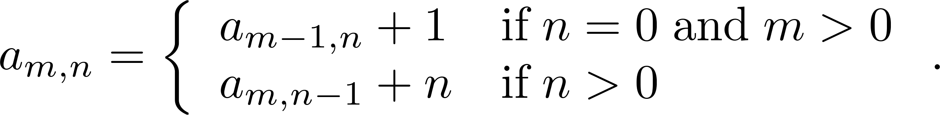
Generalized Induction
Example: Suppose that a_{m,n} is defined for (m,n)∊N ×N by
a_{0,0} = 0 and
Show that a_{m,n} = m + n(n + 1)/2 is defined for all (m,n)∊N ×N.
Solution: Use generalized induction.
BASIS STEP: a_{0,0} = 0 = 0 + (0∙1)/2
INDUCTIVE STEP: Assume that a_{m̍,n̍} = m̍+ n̍(n̍ + 1)/2 whenever(m̍,n̍) is less than (m,n) in the lexicographic ordering of N ×N .
If n = 0, by the inductive hypothesis we can conclude
a_{m,n} = a_{m−1,n} + 1 = m − 1+ n(n + 1)/2 + 1 = m + n(n + 1)/2 .
If n > 0, by the inductive hypothesis we can conclude
a_{m,n} = a_{m,n−1} + n = m + (n − 1)n/2 +n = m + (n² – n + 2n)/2 = m + n(n + 1)/2 .
⁻² .
FREE: For Complete Playlist: https://www.youtube.com/c/FahadHussaintutorial/playlists
For Code, Slide and Books: https://fahadhussaincs.blogspot.com/

Slide 48
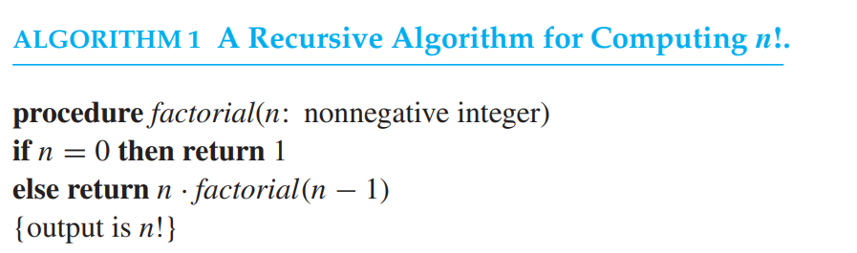
5.4 Recursive Algorithms
Definition: An algorithm is called recursive if it solves a problem by reducing it to an instance of the same problem with smaller input.
For the algorithm to terminate, the instance of the problem must eventually be reduced to some initial case for which the solution is known.
Give a recursive algorithm for computing n!, where n is a nonnegative integer.
3! = 3 · 2!, 2! = 2 · 1!,

Slide 49
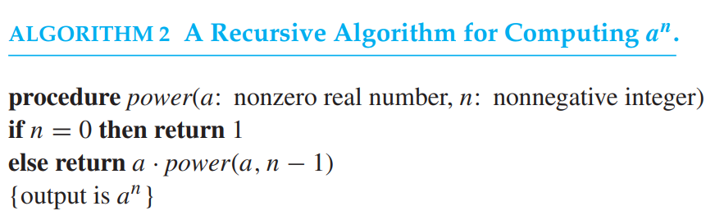
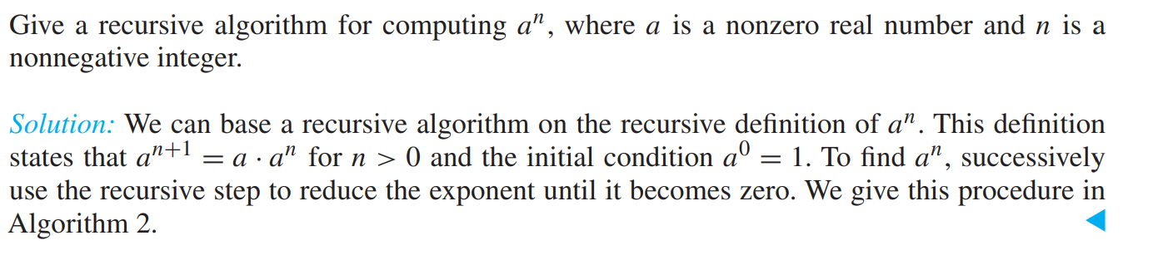
FREE: For Complete Playlist: https://www.youtube.com/c/FahadHussaintutorial/playlists
For Code, Slide and Books: https://fahadhussaincs.blogspot.com/

Slide 50
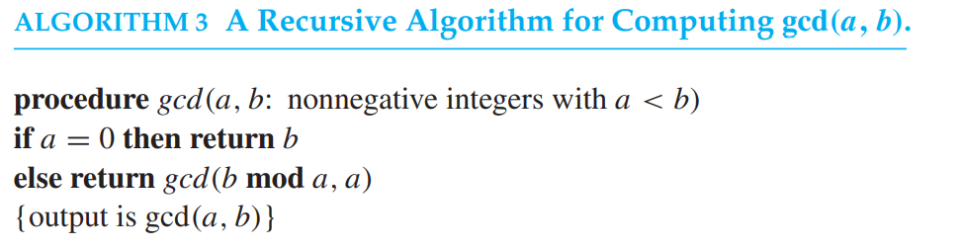
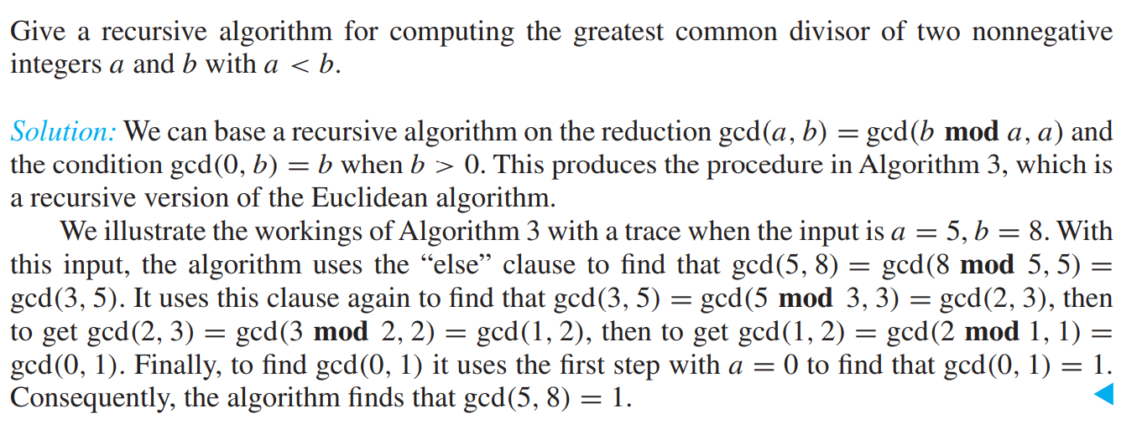
FREE: For Complete Playlist: https://www.youtube.com/c/FahadHussaintutorial/playlists
For Code, Slide and Books: https://fahadhussaincs.blogspot.com/

Slide 51
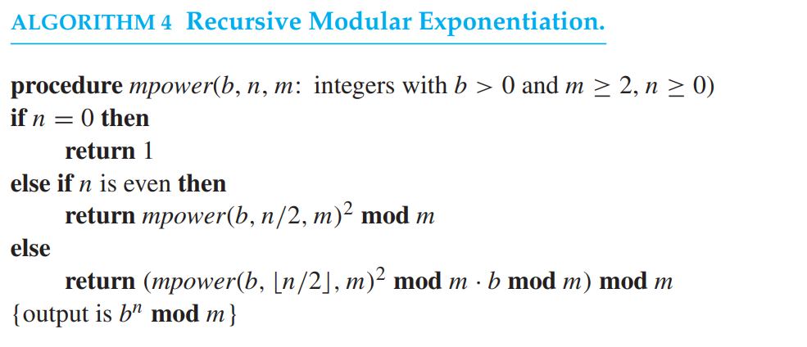
FREE: For Complete Playlist: https://www.youtube.com/c/FahadHussaintutorial/playlists
For Code, Slide and Books: https://fahadhussaincs.blogspot.com/

Slide 52
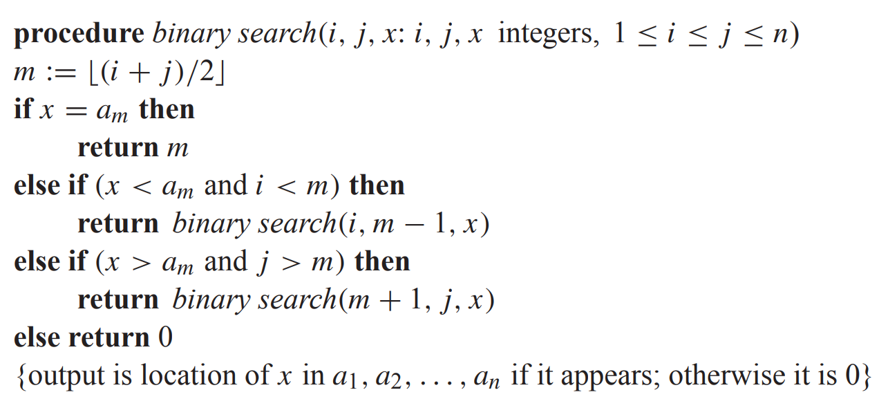
Recursive Binary Search Algorithm
Example: Construct a recursive version of a binary search algorithm.
Solution: Assume we have a₁,a₂,…, a_{n}, an increasing sequence of integers. Initially i is 1 and j is n. We are searching for x.
FREE: For Complete Playlist: https://www.youtube.com/c/FahadHussaintutorial/playlists
For Code, Slide and Books: https://fahadhussaincs.blogspot.com/

Slide 53
Recursion and Iteration
A recursive definition expresses the value of a function at a positive integer in terms of the values of the function at smaller integers.
Instead of successively reducing the computation to the evaluation of the function at smaller integers, we can start with the value of the function at one or more integers, the base cases, and successively apply the recursive definition to find the values of the function at successive larger integers. Such a procedure is called iterative.
Often an iterative approach for the evaluation of a recursively defined sequence requires much less computation than a procedure using recursion. This is illustrated by the iterative and recursive procedures for finding the nth Fibonacci number.
FREE: For Complete Playlist: https://www.youtube.com/c/FahadHussaintutorial/playlists
For Code, Slide and Books: https://fahadhussaincs.blogspot.com/

Slide 54
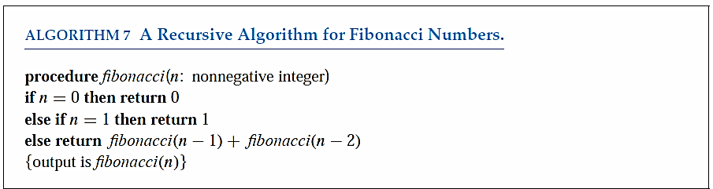
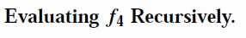
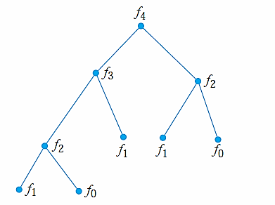
This is of order O(1.6^{n}) < O(2^{n})
FREE: For Complete Playlist: https://www.youtube.com/c/FahadHussaintutorial/playlists
For Code, Slide and Books: https://fahadhussaincs.blogspot.com/

Slide 55
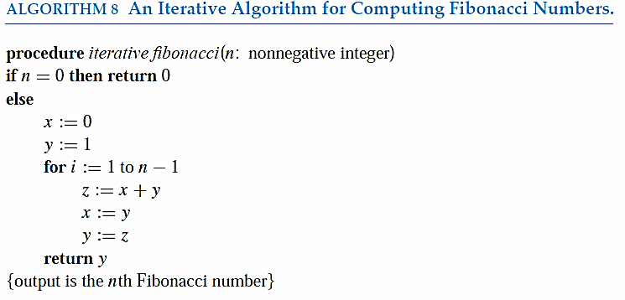
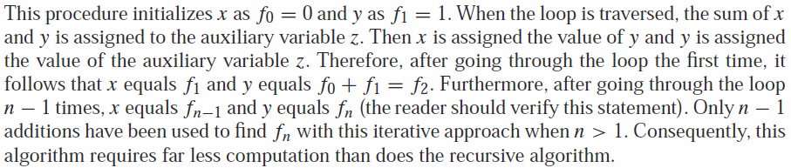
FREE: For Complete Playlist: https://www.youtube.com/c/FahadHussaintutorial/playlists
For Code, Slide and Books: https://fahadhussaincs.blogspot.com/

Slide 56
Merge Sort
Merge Sort works by iteratively splitting a list into two sublists of equal length until each sublist has one element.
Each sublist is represented by a balanced binary tree.
At each step a pair of sublists is successively merged into a list with the elements in increasing order. The process ends when all the sublists have been merged.
The succession of merged lists is represented by a binary tree.
FREE: For Complete Playlist: https://www.youtube.com/c/FahadHussaintutorial/playlists
For Code, Slide and Books: https://fahadhussaincs.blogspot.com/

Slide 57
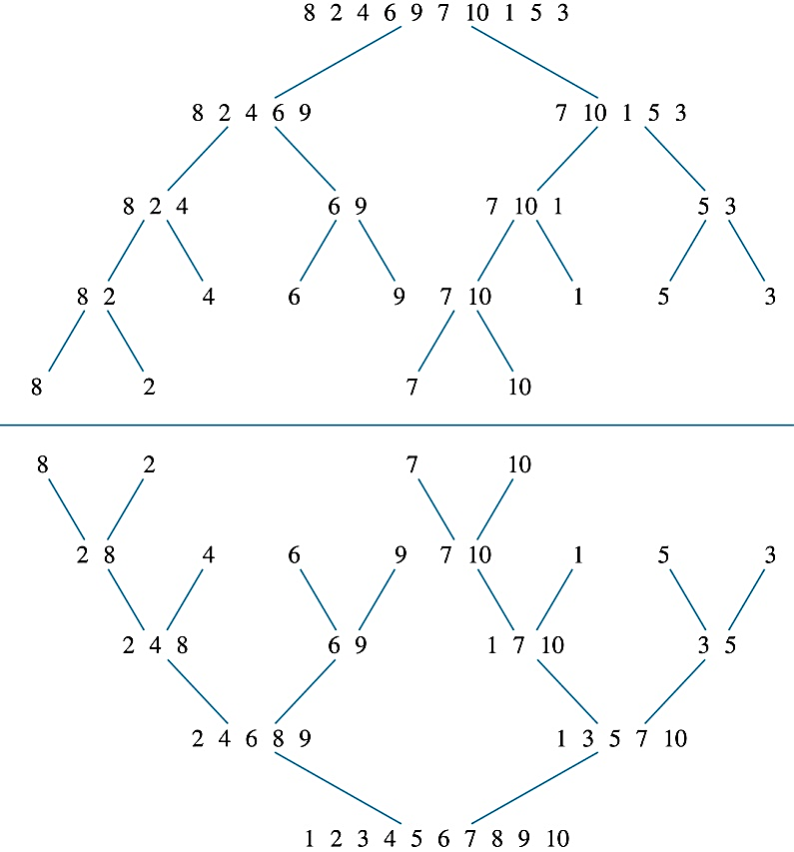
Merge Sort
Example: Use merge sort to put the list
8,2,4,6,9,7,10, 1, 5, 3
into increasing order.
Solution:
FREE: For Complete Playlist: https://www.youtube.com/c/FahadHussaintutorial/playlists
For Code, Slide and Books: https://fahadhussaincs.blogspot.com/

Slide 58
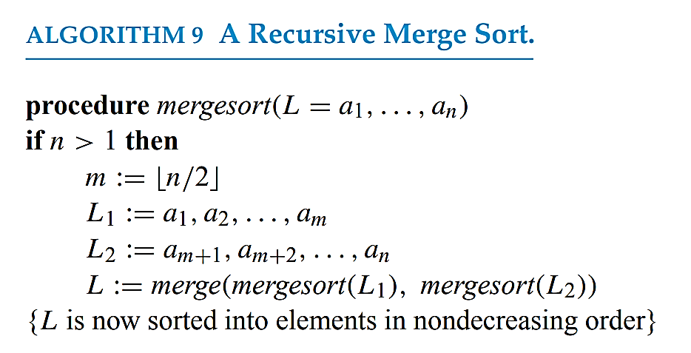
Recursive Merge Sort
Example: Construct a recursive merge sort algorithm.
Solution: Begin with the list of n elements L.
FREE: For Complete Playlist: https://www.youtube.com/c/FahadHussaintutorial/playlists
For Code, Slide and Books: https://fahadhussaincs.blogspot.com/
continued →

Slide 59
Recursive Merge Sort
Subroutine merge, which merges two sorted lists.
Complexity of Merge: Two sorted lists with m elements and n elements can be merged into a sorted list using no more than m + n − 1 comparisons.
procedure merge(L₁, L₂ :sorted lists)
L := empty list
while L₁ and L₂ are both nonempty
remove smaller of first elements of L₁ and L₂ from its list;
put at the right end of L
if this removal makes one list empty
then remove all elements from the other list and append them to L
return L {L is the merged list with the elements in increasing order}
FREE: For Complete Playlist: https://www.youtube.com/c/FahadHussaintutorial/playlists
For Code, Slide and Books: https://fahadhussaincs.blogspot.com/

Slide 60
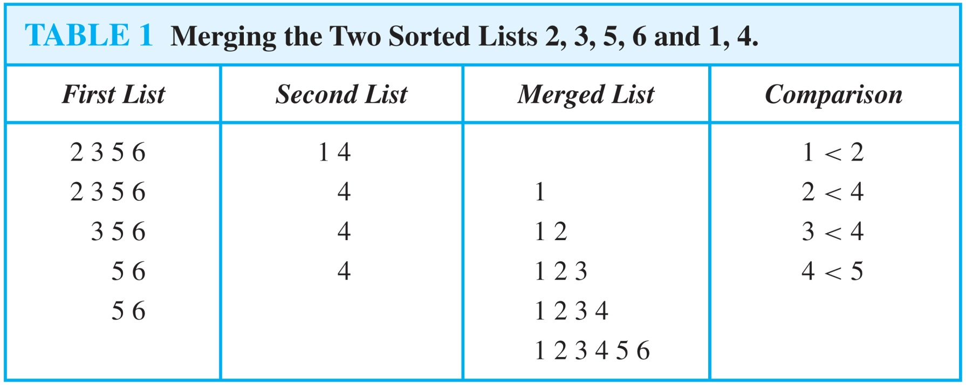
procedure merge(L₁, L₂ :sorted lists)
L := empty list
while L₁ and L₂ are both nonempty
remove smaller of first elements of L₁ and L₂ from its list;
put at the right end of L
if this removal makes one list empty
then remove all elements from the other list and append them to L
return L {L is the merged list with the elements in increasing order}
FREE: For Complete Playlist: https://www.youtube.com/c/FahadHussaintutorial/playlists
For Code, Slide and Books: https://fahadhussaincs.blogspot.com/

Slide 61
5.5 Program Correctness
Suppose that we have designed an algorithm to solve a problem and have written a program to implement it. How can we be sure that the program always produces the correct answer? After all the bugs have been removed so that the syntax is correct, we can test the program with sample input. It is not correct if an incorrect result is produced for any sample input. But even if the program gives the correct answer for all sample input, it may not always produce the correct answer (unless all possible input has been tested). We need a proof to show that the program always gives the correct output.
Program Verification A program is said to be correct if it produces the correct output for every possible input. A proof that a program is correct consists of two parts. The first part shows that the correct answer is obtained if the program terminates. This part of the proof establishes the partial correctness of the program. The second part of the proof shows that the program always terminates. To specify what it means for a program to produce the correct output, two propositions are used. The first is the initial assertion, which gives the properties that the input values must have. The second is the final assertion, which gives the properties that the output of the program should have, if the program did what was intended. The appropriate initial and final assertions must be provided when a program is checked.
FREE: For Complete Playlist: https://www.youtube.com/c/FahadHussaintutorial/playlists
For Code, Slide and Books: https://fahadhussaincs.blogspot.com/

Slide 62
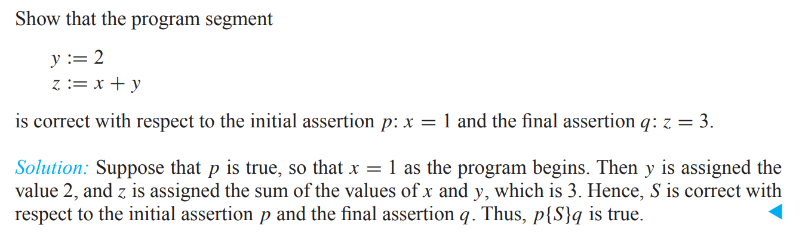
5.5 Program Correctness
A program, or program segment, S is said to be partially correct with respect to the initial assertion p and the final assertion q if whenever p is true for the input values of S and S terminates, then q is true for the output values of S. The notation p{S}q indicates that the program, or program segment, S is partially correct with respect to the initial assertion p and the final assertion q. Note: The notation p{S}q is known as a Hoare triple. Tony Hoare introduced the concept of partial correctness
FREE: For Complete Playlist: https://www.youtube.com/c/FahadHussaintutorial/playlists
For Code, Slide and Books: https://fahadhussaincs.blogspot.com/

Slide 63
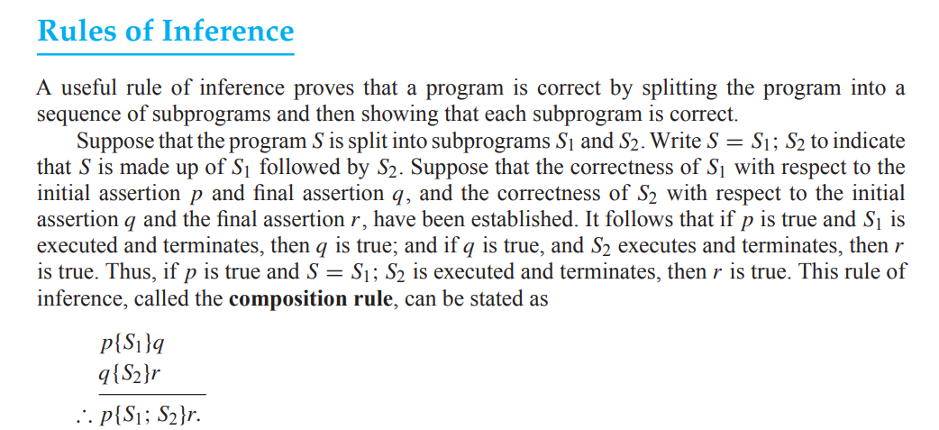
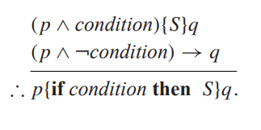
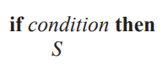
Rules of Inference
Conditional Statements
FREE: For Complete Playlist: https://www.youtube.com/c/FahadHussaintutorial/playlists
For Code, Slide and Books: https://fahadhussaincs.blogspot.com/

Slide 64
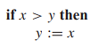
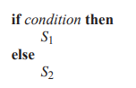
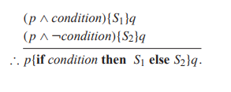
5.5 Program Correctness
EXAMPLE 2 Verify that the program segment
is correct with respect to the initial assertion T and the final assertion y ≥ x.
Similarly, suppose that a program has a statement of the form
FREE: For Complete Playlist: https://www.youtube.com/c/FahadHussaintutorial/playlists
For Code, Slide and Books: https://fahadhussaincs.blogspot.com/

Slide 65
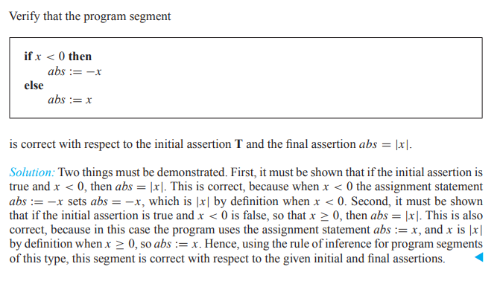
5.5 Program Correctness
FREE: For Complete Playlist: https://www.youtube.com/c/FahadHussaintutorial/playlists
For Code, Slide and Books: https://fahadhussaincs.blogspot.com/

Slide 66
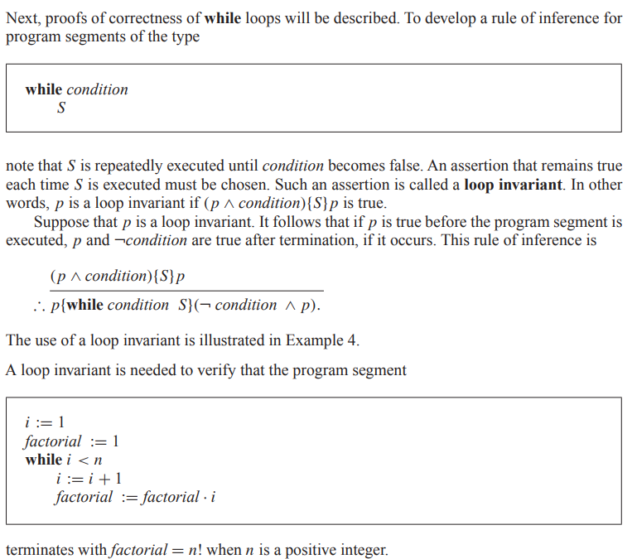
Loop Invariants
FREE: For Complete Playlist: https://www.youtube.com/c/FahadHussaintutorial/playlists
For Code, Slide and Books: https://fahadhussaincs.blogspot.com/

